Slide 1
TriMet Trip Roadmap 2017
Thoughts on where we're going. Both
OTP & trimet.org upgrade + MOD Grant
December 2016

Slide 2
Roadmap: Projects
OTP 1.1.0 Upgrade … Full Release in Jan
Loader Project … Ongoing
Map Server Move … 2017
trimet.org Front End in React … Initial Stages
MOD Grant OTP React … 2017
MOD Grant GeoCoder … 2017
MOD Grant OTP Backend … 2017
OTHER – Route Landing pages … yet prioritized
OTHER – SUM on other pages … yet prioritized

Slide 3
Roadmap: OTP 1.1.0 Upgrade
Spent a good portion of 2016 working with Conveyal fixing bugs and getting functionality correct and back to normal.
Retrofitted our current trip and map planner tools to work with both old and new OTP. Switching back and forth should just work (i.e., rollback)
Testing with the call center past 2 months; start testing with TTO / fieldtrips this week (Dec 7th)
Roll call to new OTP in Dec/Jan … 2 weeks later or so later we'll roll public site to new OTP
Sets us up for MOD Grant work next...

Slide 4
Roadmap: Loader Project
In prep for OTP 1.1 and Server upgrades, rewrote / refactored the in-house scripts and tools that support OTP, GTFS and OSM loading
More work needed here: SOLR loading, Pelias?, gtfs-rt, etc...

Slide 5
Roadmap: Server Move
In 2017, I plan to work on moving off the map servers and into John Zimmerman's hosted env
Pelias: this system will never be loaded on the maps servers, and land in JZ's environment.
GeoServer / Boundless Suite: need to get away from TileCache … so the Suite is a way to go
Loader project: changes needed to build and load things in new environment. Plus new apps.

Slide 6
Roadmap: trimet.org Front End
A contractor (Sean) has started rewriting the trimet.org Front End with React.js
We need to eventually define how trimet.org will change with the MOD Grant deliverables
Sean's React.js rewrite of trimet.org will have a placeholder for the trip planner tab
Initial Question:
  Will the MOD Grant deliver a fully functional trip component that fits into the placeholder tab?
  Or will the MOD Grant deliver a component library that someone like Sean could use to build out a custom planner tool within the trimet.org Front End?

Slide 7
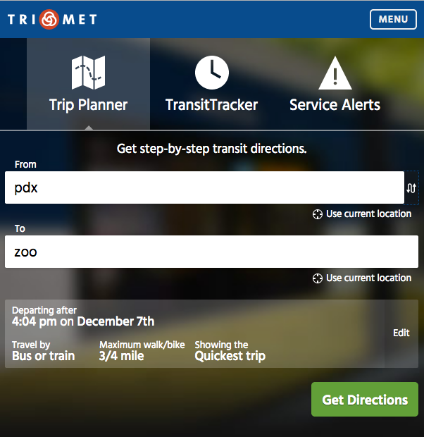
Roadmap: trimet.org Front End
Things to look at:
This is the current trimet.org front end, and the trip planner tab
Do we ask for a React component that fits into this tab? (And is that realistic? … this is a weighted question on multiple levels)
Or do we rather have a new React.js component toolkit from the MOD Grant that allows us to easily build a custom trip widget for trimet.org?

Slide 8
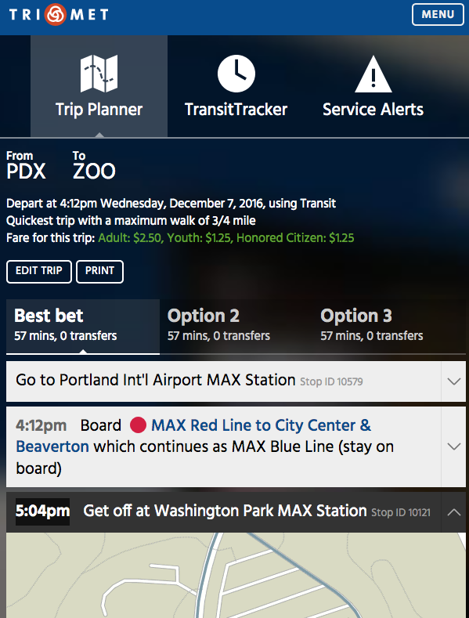
Roadmap: trimet.org Front End
Things to look at:
trimet.org is primarily a text trip planner, with a smattering of small map widgets
The MOD Grant project is interactive map focused … do we ask to build both?
When David and I were originally talking about a new OTP / React project, it was more in the vein of a component toolkit.
In that model, we'd get a generic interactive map, as well as tools to build custom apps

Slide 9
Roadmap: trimet.org Front End
Conveyal is building a map replacement...
Do we also use this map to replace mobilitymap.trimet.org?
What about internal mapping needs? TriMet webapp? Alerts / reroute system?
e.g., we have a lot of different mapping needs...how do we create a tool that can be leveraged to quickly build maps that integrates well with our back-end mapping infrastructure?

Slide 10
Roadmap: Pelias GeoCoder
At this early date, we have options how we're going to fill functional gaps we have with Pelias.
For example: we currently calculate an in / out of the TriMet district for Oregon DOR / TriMet Tax.
  It might be trivial to configure Pelias to do the same thing … so no big deal.
  Or maybe it's not worth the effort to adapt Pelias in this way. If that's the case, we'll need to create a separate solution to calculate in/out on the fly.
  For other technical gaps, we may find ourselves choosing to simply retire the existing function

Slide 11
Roadmap: OTHER
Dave Whipple has asked IT about automating Route Landing Pages (and other pages) that are currently manually maintained. Not prioritized yet, but...
We could add SUM data to other pages, like Stop Landing Pages:
  nearest car2go / / uber / etc...
  nearest BIKETOWN bike racks
I asked ReachNow (BMW) if they have a developer api. Their marketing manager Alan.Bates@team.reachnow.com wants to talk.

